Slide 1
DATA WAREHOUSING
By
Syed Bakhtawar Shah Abid
Assistant Professor
Department of Computer Science
Data Warehousing

Slide 2
Normalization
The process of decomposing relations with anomalies to produce smaller , well structured relations.
The analysis of functional dependencies is called normalization.
Data Warehousing

Slide 3
Functional dependency
A constraint between two attributes in which the value of one attribute is determined by the value of another attribute. i.e.
for any relation R, attribute B is functionally dependent on attribute A, if for every valid instance of A, that value of A uniquely determines the value of B and is represented as
Data Warehousing

Slide 4
Functional dependency
A constraint between two attributes in which the value of one attribute is determined by the value of another attribute. i.e.
for any relation R, attribute B is functionally dependent on attribute A, if for every valid instance of A, that value of A uniquely determines the value of B and is represented as A B
Data Warehousing

Slide 5
Functional Dependencies
An attribute may be functionally dependent on a single attribute or a collection of attributes as
Std_id , Course_Title Date Completed
Comma serves as a logical AND operator.
Other example.
SSN Name , address , DOB
VIN Make , Model , Color
ISBN Title , Author , Publisher
Data Warehousing

Slide 6
Functional Dependency
Determinant : An attribute in a relation that uniquely determine the value of another attribute.
The attribute(s) on the left hand side of the arrow is/are called determinant.
e.g.
Std_id , Course_Title
SSN
VIN
ISBN
Data Warehousing

Slide 7
Functional dependencies
1. Full functional dependency : A dependency in which the non key attributes are fully functionally dependent on the primary key.
2. Partial dependency : a functional dependency in which one or more non key attributes are functionally dependent on part (but not all ) of the primary key.
3. Transitive dependency: A functional dependency in which one attribute functionally determines a second, which functionally determines a third
Data Warehousing

Slide 8
Normalization
Used
  1. During conceptual data Modeling i.e. during E-R Diagram
  2. During Logical Data Base Design. i.e. during mapping E-R diagrams into Relations
  3. Reverse Engineering Older Systems
Data Warehousing

Slide 9
Normalization
Goals of normalization
  Reducing data redundancy to avoid anomalies and save storage space.
  Simplify the enforcement of referential integrity.
  Making data maintenance easier (insert , update , delete ).
Data Warehousing

Slide 10
Normalization
Steps in normalization.
  Normalization is accomplished in stages, each of which corresponds to a normal form
  Normal form : a state of a relation that results from applying simple rules regarding functional dependencies for relationship between attributes to that relation.
Data Warehousing

Slide 11
Well Structured Relation
A relation that contains minimal redundancy and allows the users to insert , modify , and delete rows in a table without errors or anomalies (inconsistencies).
Minimize data redundancy
  Save storage space
  Avoid data inconsistencies (anomalies) when insert, delete, and update rows.
Data Warehousing

Slide 12
Anomalies
    Definition : an error or inconsistency that may result when a user attempts to manipulate a table that contain redundant data. The three types of anomalies are
      Insertion Anomaly – as the primary key is the combination of both the emp_id and Course_Title, so to add a new employee, course information should be added.
      Deletion Anomaly – deleting rows may cause a loss of data that would be needed for other future rows
      Modification Anomaly – changing data in a row forces changes to other rows because of duplication
Emp_id | Course_Title | Date_Completed
Data Warehousing

Slide 13
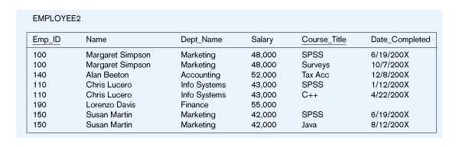
Example
Insertion – can’t enter a new employee without having the employee take a class
Deletion – if we remove employee 140, we lose information about the existence of a Tax Acc class
Modification – giving a salary increase to employee 100 forces us to update multiple records
Why do these anomalies exist?
  Because we’ve combined two entity types into one relation. This results in duplication, and an unnecessary dependency between the entities
Data Warehousing

Slide 14
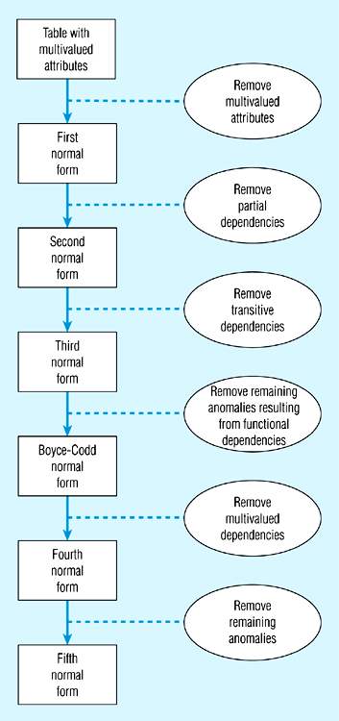
Steps in normalization
Normal form is a state of a particular relation regarding functional dependencies.
Data Warehousing

Slide 15
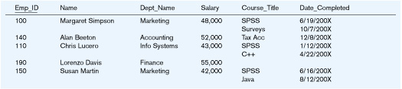
First Normal Form
No multivalued attributes
Every attribute value is atomic
Table 1is not in 1st Normal Form (multivalued attributes) ➔ it is not a relation
Table 2 is in 1st Normal form
All relations are in 1st Normal Form
Data Warehousing

Slide 16
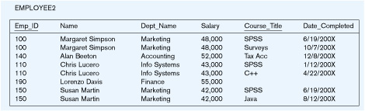
Second Normal Form
1NF plus No partial functional dependencies
  Every non-key attribute must be defined by (fully functionally dependent on) the entire key, not by only part of the key
EMPLOYEE2 is NOT in 2nd Normal Form (salary is only dependent on Emp_id)
Data Warehousing

Slide 17
Functional Dependencies in EMPLOYEE2
Dependency on entire primary key
EmpID
CourseTitle
Name
DeptName
Salary
DateCompleted
Dependency on only part of the key
EmpID, CourseTitle ➔ DateCompleted
EmpID ➔ Name, DeptName, Salary
Therefore, NOT in 2nd Normal Form!!
Data Warehousing

Slide 18
Getting it into 2nd Normal Form
decomposed into two separate relations
Both are full functional dependencies
EmpID
Name
DeptName
Salary
EmpID
CourseTitle
DateCompleted
Data Warehousing

Slide 19
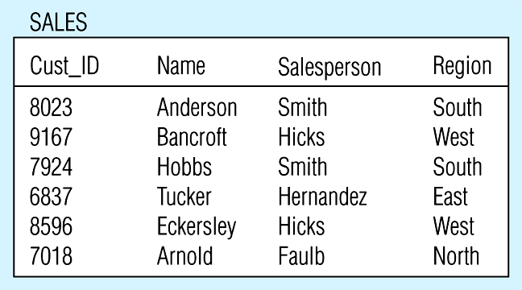
Third Normal Form
2NF PLUS no transitive dependencies
  one attribute functionally determines a second, which functionally determines a third)
Sales is NOT in 3nd Normal Form (Region is depend on Salesperson)
Data Warehousing

Slide 20
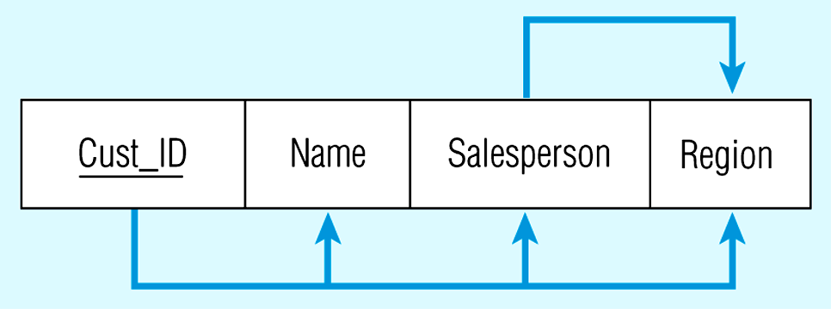
Relation with transitive dependency
CustID → Name
CustID → Salesperson
CustID → Region
All this is OK
(2nd NF)
BUT
CustID → Salesperson → Region
Transitive dependency
(not 3rd NF)
Data Warehousing

Slide 21
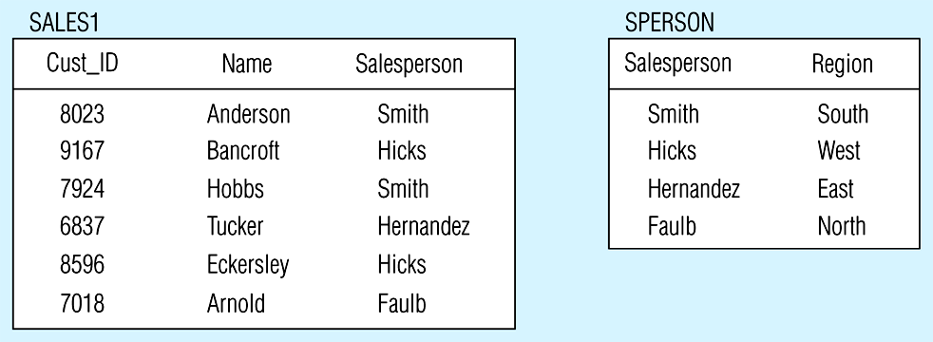
Removing a transitive dependency
Decomposing the SALES relation
Data Warehousing

Slide 22
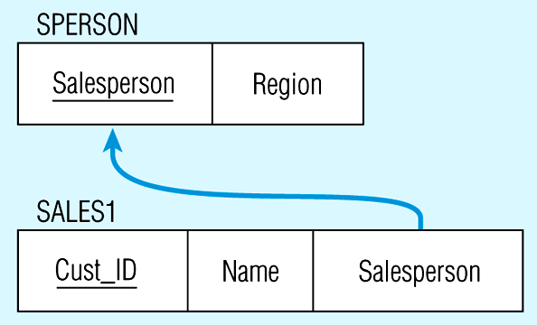
Relations in 3NF
Salesperson → Region
CustID → Name
CustID → Salesperson
Now, there are no transitive dependencies…
Both relations are in 3rd NF
Data Warehousing

Slide 23
Boyce Codd Normal Form
A relation is said to be in BCNF if and only every determinant is candidate key.
SID | Major | Advisor | GPA
1 | DB | Abid | 3.5
2 | C++ | Arshad sb | 3.6
Data Warehousing

Slide 24
Boyce Codd Normal Form
SID | Advisor | Major | GPA
But here partial dependency occurs between major and advisor
SID | Major | GPA
Major | Advisor
Data Warehousing

Slide 25
Fourth Normal Form
A relation is said to be in 4th normal form if it is in BCNF and contains no multivalued dependency.
Multivalued Dependency: a type of dependency that exists when there are at least three attributes say A,B,C in a relation with a well defined set of B and C values for each A value, but those B and C values are independent of each other.
Data Warehousing

Slide 26
Fourth Normal Form
Course | Instructor | Text Book
Course | Instructor
Course | Text Book
Data Warehousing

